Slide 1
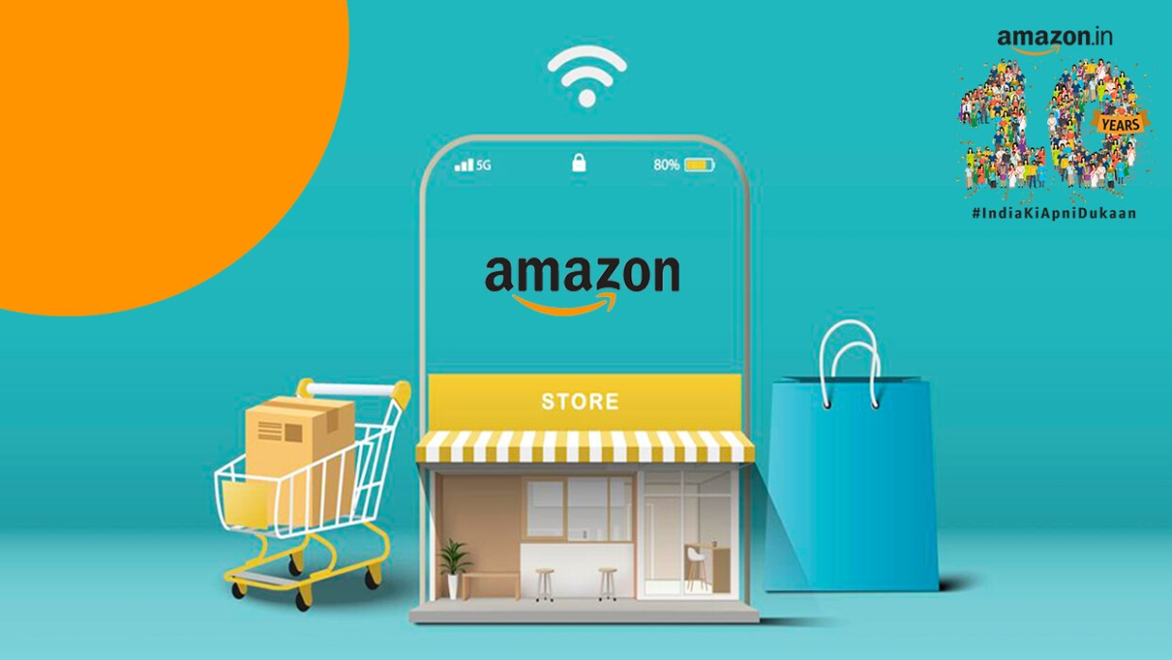

Amazon E Commerce
Mr. Ashwin Dubey
Date: 14/03/2024

Slide 2

Agenda
Topic Highlights
Introduction and Objectives with Problem Statement
Analysis of Objective Questions
Insights from Subjective Questions
Strategic Recommendations
Dashboard and Visualizations
Conclusion
Acknowledgements and References

Slide 3
Introduction and Objectives
Welcome to our amazon e-commerce project! We use data-driven insights to shape strategic decisions in online retail. Our dataset provides a comprehensive snapshot of product attributes, customer behavior, pricing, and reviews, empowering us to extract valuable recommendations for stakeholders.
Key steps:
Data cleansing: ensuring data reliability.
Exploratory data analysis (EDA): uncovering patterns and trends.
Strategic recommendations: providing actionable insights.
Performance evaluation: assessing current product performance.
Let's leverage power bi to transform raw data into actionable intelligence!

Slide 4
Problem Statement
You are working as a business analyst at amazon, a company currently performing well. The stakeholders wish to maintain this level of performance and seek improvement. For this purpose, they want to devise new strategies. You are part of a team exploring new ways to benefit customers, such as offering more discounts and prime membership perks. Could you suggest additional methods to identify and reward customers and enhance their shopping experience?

Slide 5
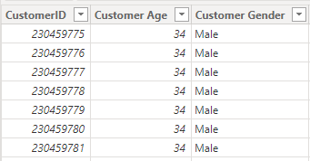
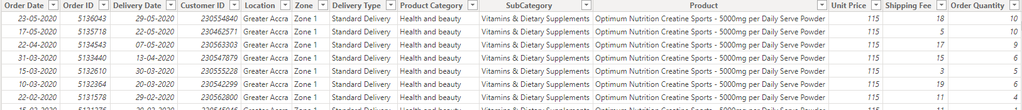
Data Overview
Customer table having 3 columns.
Description: provides customer id, customer age, customer gender
Orders table having 17 columns.
Description: provides order date, order id, delivery date, customer id, location, zone, delivery type, product category, subcategory, product, unit price, shipping fee, order quantity, sale price, status, reason, rating

Slide 6
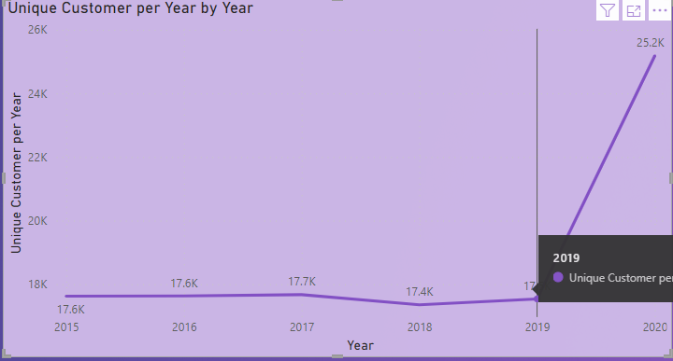
Analysis of Objective Questions
1. Revenue Analysis
Total Revenue: Sum of delivered and returned orders.
Net Revenue: Gross revenue minus returned revenue.
Gross Revenue: Initial calculation of total sales.
Returned Revenue: Revenue from later-returned sales.
Delivered Revenue: Revenue from successfully delivered sales.
2. Remarkable Growth: Unique Customer Purchases
TOTAL UNIQUE CUSTOMERS (2020): ~25.2K
SIGNIFICANT INCREASE FROM 2019 (17.5K)
KEY INSIGHT FOR STRATEGIC DECISIONS

Slide 7
Analysis of Objective Questions
3. Sales Data Insights
Most Popular Products:
Avon Soft Musk Eau de Toilette Spray – 50ml: 14,444 in order quantity sold total.
Most Popular Categories:
Health and Beauty: Approximately 1,98,550 in order quantity sold total.
Most Popular Subcategories:
Vitamins & Dietary Suppliements: Close to 70,553 in order quantity sold total.
This data reflects customer preferences and highlights sales performance across different product segments.

Slide 8
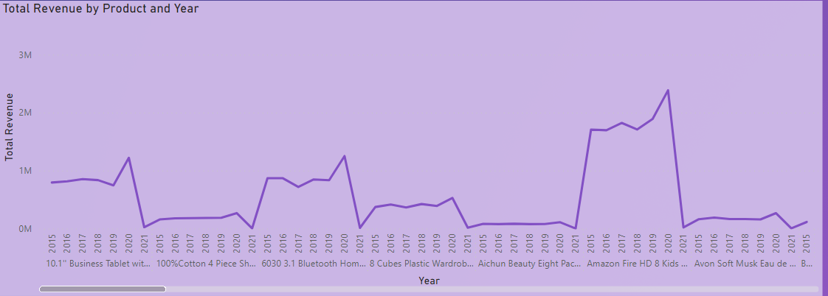
Analysis of Objective Questions
4. Sales Growth Analysis
YoY Growth:
Measures annual change in sales.
Compares current year to previous year.
Key metric for performance evaluation.
Steps:
Prepare data with relevant columns.
Create ‘Total Sales by Year’ measure.
Calculate ‘YoY Growth’ using DAX logic.
Visualize data (bar or line chart).
Apply conditional formatting.
Analyze trends for strategic insights.

Slide 9
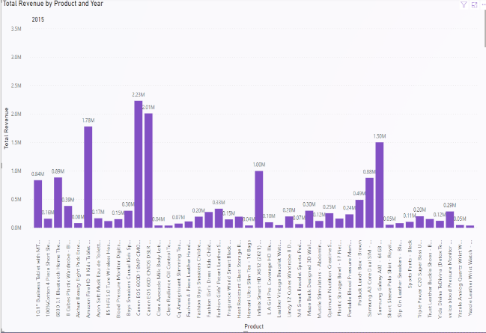
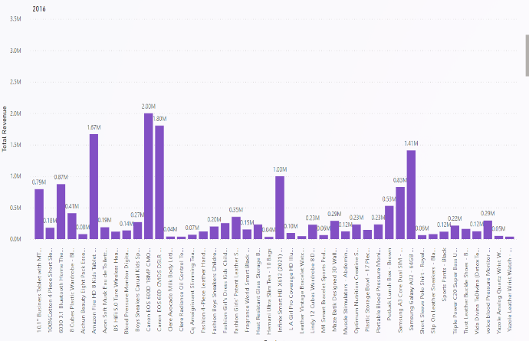
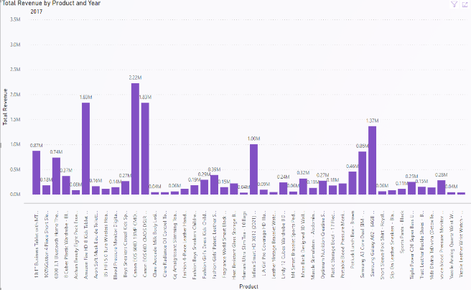
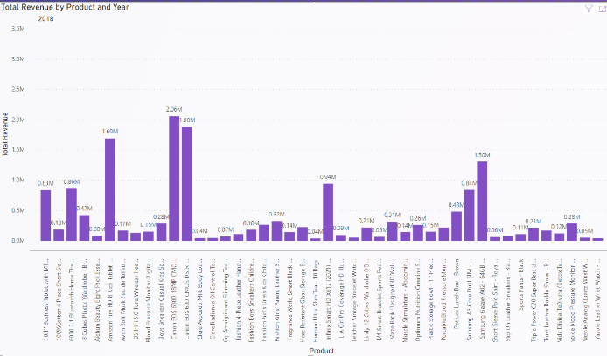
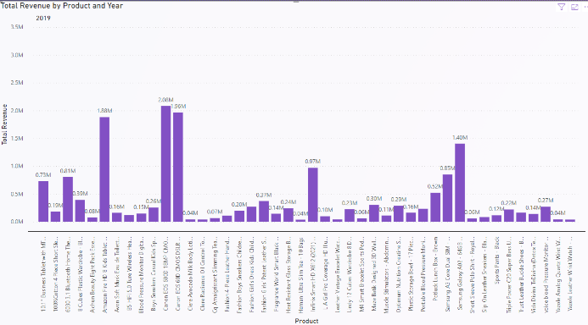
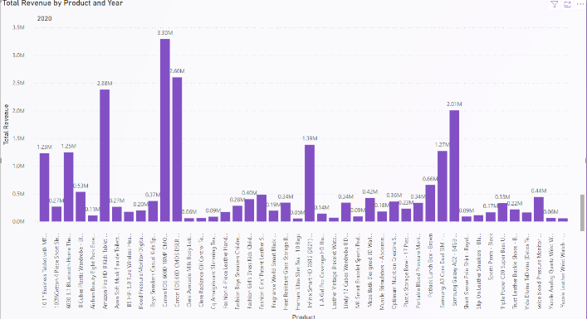
Insights from Subjective Questions
1. Product Contribution Analysis
Contribution Margin:
Measures how much each product contributes to covering fixed costs and generating profit.
Calculated as: Sale Price - Variable Cost
Insights (Till 2020):
Canon EOS 600D: Consistently High Revenue.
Amazon Fire HD 8: Steady Performance.
Samsung Galaxy A02: Moderate Revenue.
Other Products: Varied Results.

Slide 10
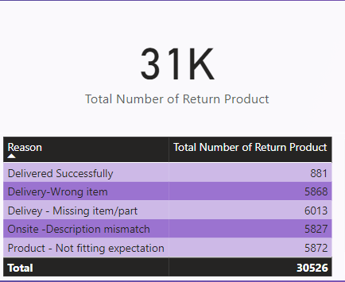
Insights from Subjective Questions
2. Product Return Insights
Returned products (2020): 31k
Key issue: 6065 returns due to “quality and defective item.”
Improvement areas:
Product descriptions: ensure accuracy and clarity.
Quality control: minimize defective products.
Customer service training: efficient handling of returns.
Customer feedback: enhance overall quality.
Transport mode selection: optimize transit choices.
These steps reduce returns and improve satisfaction.

Slide 11
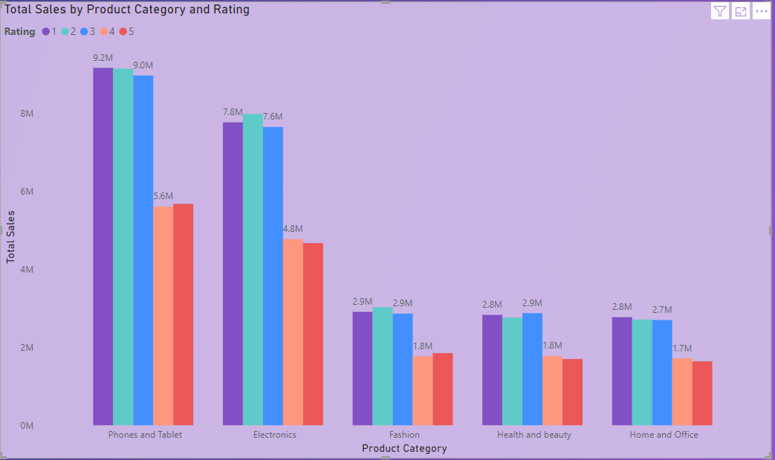
Insights from Subjective Questions
3. Ratings Impact On Sales
Visualization: bar chart (product vs. Total sales).
Analysis:
High-rated products sell well (ratings 2-3).
Consider other factors (quality, marketing, reviews).
Conclusion: ratings matter, but a holistic approach is essential.

Slide 12
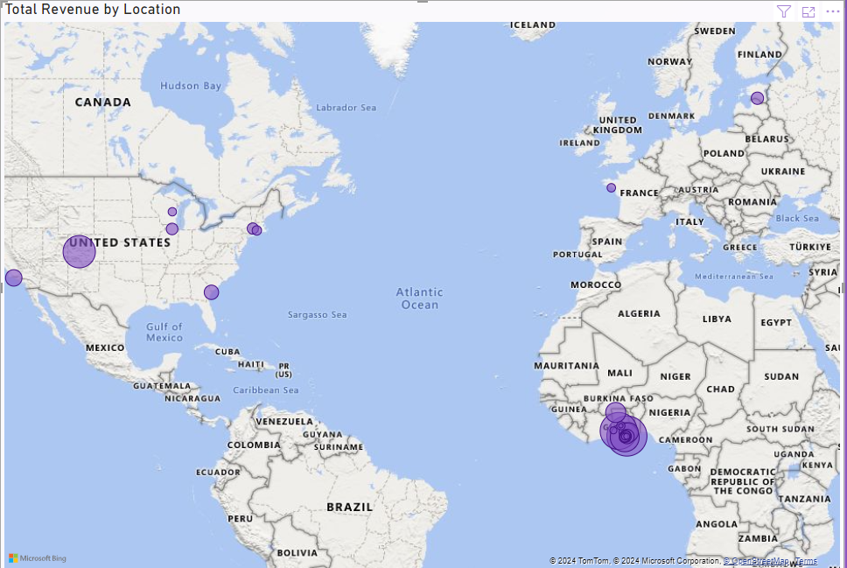
Insights from Subjective Questions
4. Revenue Insights By Location
Visualization:
Map chart displays revenue distribution.
Notably, “Greater Accra” region contributes significantly.
Strategic implications:
Market segmentation:
Tailor marketing based on location trends.
Resource allocation:
Allocate resources strategically.
Competitive advantage:
Outperform competitors in specific areas.
Risk mitigation:
Diversify across locations.
Monitor revenue fluctuations.
Location-based insights drive strategy.

Slide 13
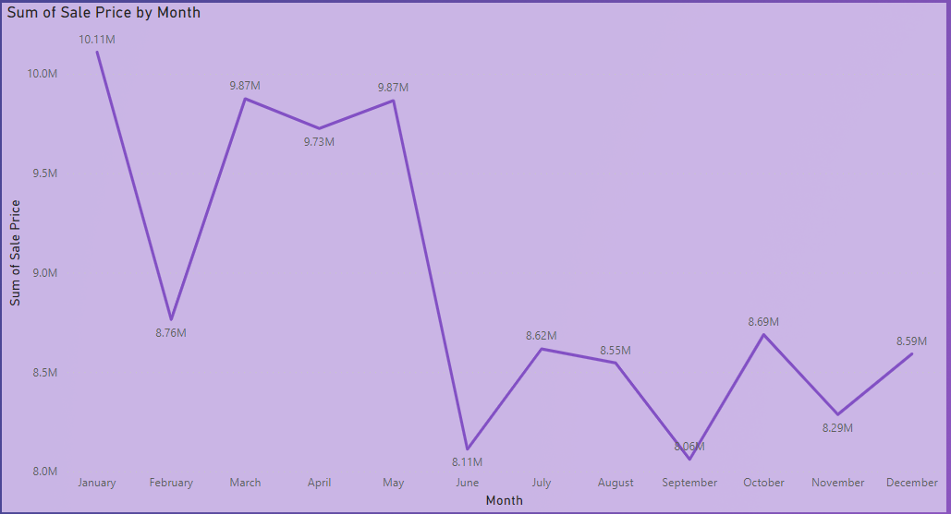
Insights from Subjective Questions
5. Sales Optimization Insights
Visualization:
Line chart shows sales trends over time.
Identify declining months (e.g., June, September).
Strategies:
Seasonal promotions:
Offer discounts or bundles.
Leverage holidays.
Flash sales:
Create urgency.
Highlight exclusivity.
Social media engagement:
Run interactive content.
Host contests.
Email campaigns:
Announce promotions.
Personalize offers.
Localized advertising:
Tailor ads to regions.
Collaborate with local influencers.
Cross-sell and upsell:
Suggest related products.
Bundle complementary items.
Conclusion:
Strategic promotions optimize sales.

Slide 14
6. Product Marketing insights
Visualization:
Table analyzes revenue, unit price, and order quantity.
Focus on high-priced items with low orders.
Strategies:
Promotional campaigns:
Target underperforming high-priced products.
Highlight benefits and address objections.
Pricing adjustments:
Improve competitiveness.
Bundle complementary items.
Customer education:
Communicate premium product value.
Leverage content marketing.
Segmented marketing:
Tailor messaging to interested segments.
Resource allocation:
Allocate budgets strategically.
Prioritize effective channels.
Conclusion:
Optimize sales and profitability.

Slide 15
Insights from Subjective Questions
7. Customer Loyalty Program Insights
Understand your customer base:
Analyze existing customer data.
Consider demographics, behavior, and preferences.
Tailor incentives effectively.
Segmentation strategies:
Tiered programs:
Create loyalty tiers (e.g., Gold, silver, bronze).
Offer escalating benefits.
Behavior-based segmentation:
Reward specific behaviors (e.g., Referrals).
Demographic segmentation:
Customize benefits for age groups, professions, or interests.
Program elements:
Points system:
Assign points for every purchase.
Redeem for discounts or exclusive experiences.
Discounts and offers:
Provide regular discounts and promotions.
Personalized rewards:
Tailor rewards to preferences.
VIP treatment:
Offer priority service and exclusive events.
Referral bonuses:
Encourage successful referrals.

Slide 16
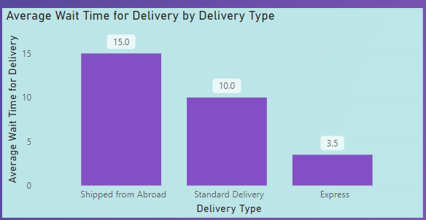
Insights from Subjective Questions
8. Delivery Insights
Comparison:
Express: shortest waiting time.
Standard: balance of speed and cost.
Shipped from abroad: longest wait (international shipping).
Resource allocation:
Staff during peak delivery times.
Tailor to each delivery type.
Customer expectations:
Set realistic delivery estimates.
Communicate wait times upfront.

Slide 17
Strategic Recommendations
1. Customer-centric approach:
Prioritize customer needs and preferences.
Enhance personalized experiences.
2. Digital transformation:
Invest in technology for efficiency.
Optimize online channels and user interfaces.
3. Data-driven decision making:
Leverage data analytics for insights.
Base strategies on evidence and trends.
4. Agile adaptation:
Stay flexible and responsive.
Adjust strategies as needed.
5. Delivery optimization:
Resource allocation:
Staff during peak delivery times.
Tailor to each delivery type.
Customer expectations:
Set realistic delivery estimates.
Communicate wait times upfront.

Slide 18
Strategic Recommendations
6. Loyalty program enhancement:
Segmentation strategies:
Create loyalty tiers (e.g., Gold, silver, bronze).
Reward specific behaviors (e.g., Referrals).
Customize benefits for different demographics.
Program elements:
Assign points for every purchase.
Provide regular discounts and personalized rewards.
Offer VIP treatment and referral bonuses.
7. Sales optimization insights:
Seasonal promotions:
Offer discounts or bundles during specific times.
Leverage holidays for targeted campaigns.
Flash sales:
Create urgency and highlight exclusivity.
Social media engagement:
Run interactive content and host contests.
Email campaigns:
Announce promotions and personalize offers.
Localized advertising:
Tailor ads to specific regions.
Collaborate with local influencers.
Cross-sell and upsell:
Suggest related products and bundle complementary items.

Slide 19
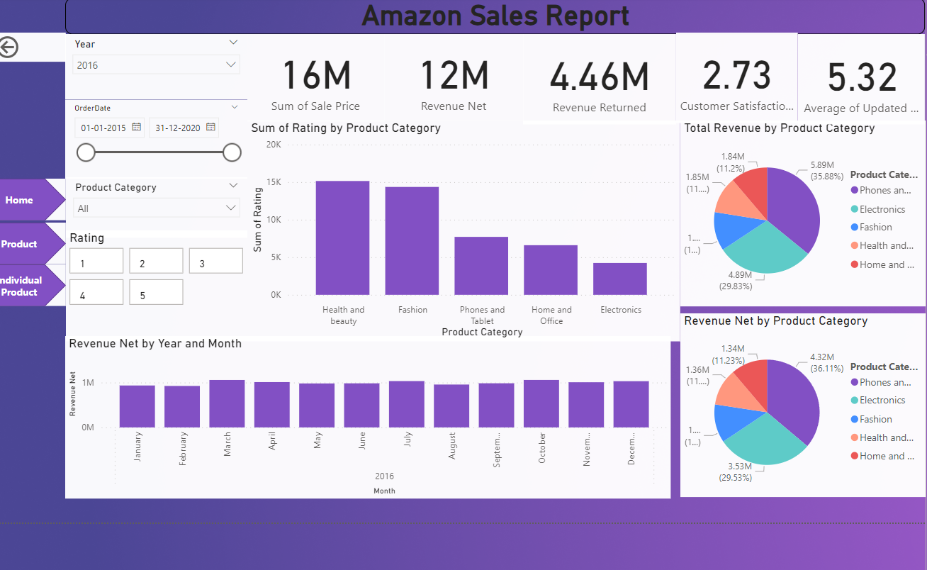
Dashboard and Visualizations

Slide 20
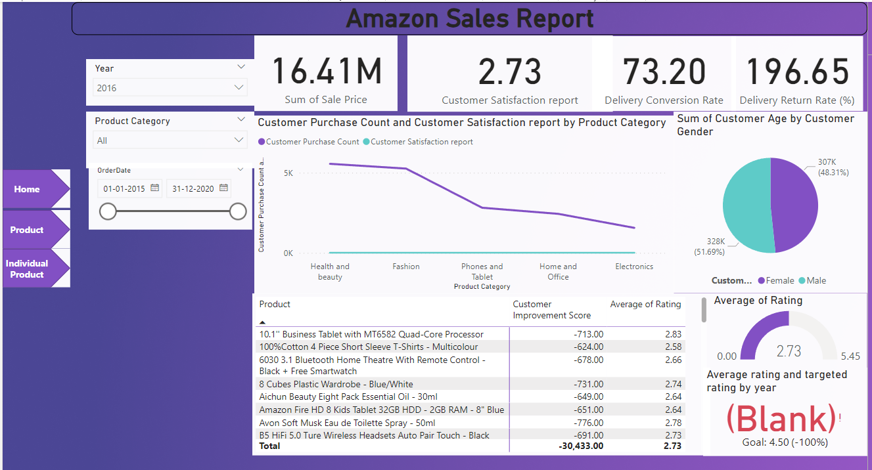
Dashboard and Visualizations

Slide 21
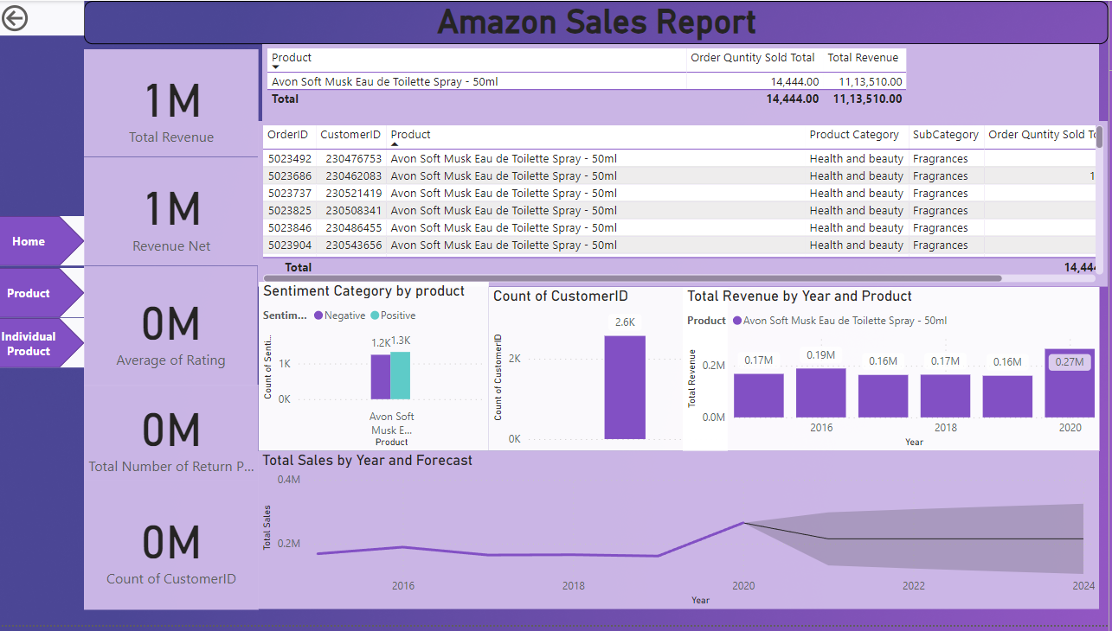
Dashboard and Visualizations

Slide 22
Conclusion
In our journey through insights and strategies, we’ve uncovered valuable pathways for success. Let’s reflect:
Strategic insights matter:
A customer-centric approach fuels growth.
Data-driven decisions lead to informed strategies.
Agile adaptation ensures resilience.
Delivery and loyalty:
Optimize delivery for customer satisfaction.
Enhance loyalty programs for lasting connections.
Sales and marketing:
Leverage insights for revenue growth.
Prioritize high-impact strategies.

Slide 23
Acknowledgements And References
In our quest for knowledge, we owe gratitude to these guiding stars:
Amazon e-commerce reports:
Insights from the e-commerce cosmos.
Shaped our understanding of market trends.
Newton school, 2024:
PowerBi e-commerce trends and forecasts.
Our compass through data currents.
Rushika kale’s data magic:
Her data cleaning spells improved our PowerBi craft.
We owe her a wizard’s debt.
PowerBi version 2.126.927.0:
Our trusty steed across pixelated realms.
Whispering, “visualize, analyze, conquer.”
PowerBi desktop and NovyPro:
Our loyal companions bridging screens and minds.
They carried insights beyond pixels.
And so, dear audience, as we conclude this chapter, remember: insights are the constellations that guide our ships. Acknowledge the stars, honor the data, and may your journey be ever illuminated.
🌟 May your dashboards be ever dynamic, and your insights—ever profound. 🌟

